Slide 1


MAPREDUCE

Slide 2
MAPREDUCE
Pros and cons of Hadoop
Hadoop Map Reduce paradigm
Map and reduce tasks.
Job Tracker and task tracker.
Map reduce execution pipeline,
Key value pair,
Shuffle and sort,
Combiner and Partitioner,
APIs used toWrite/Read files into/from Hadoop,
Hadoop 2.0 Features,
Name Node High Availability,
YARN Architecture.

Slide 3
Hadoop Mapreduce paradigm
Hadoop is an open-source software framework for storing and processing large datasets ranging in size from gigabytes to petabytes.
Developed at the Apache Software Foundation.
Basically two components in Hadoop:
1. Massive data storage
2. Faster data processing

Slide 4
Hadoop Mapreduce paradigm
Hadoop distributed File System (HDFS):
  It allows you to store data of various formats across a cluster.
Map-Reduce:
  For resource management in Hadoop. It allows parallel processing over the data stored across HDFS.

Slide 5
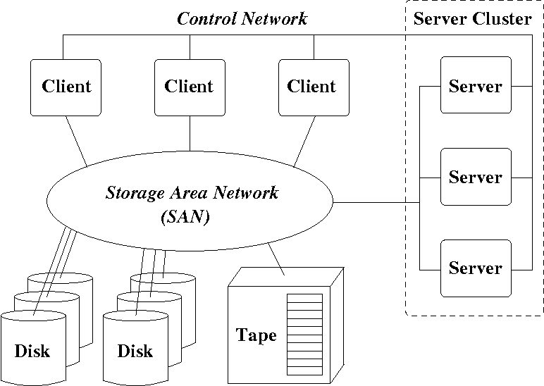

Slide 6
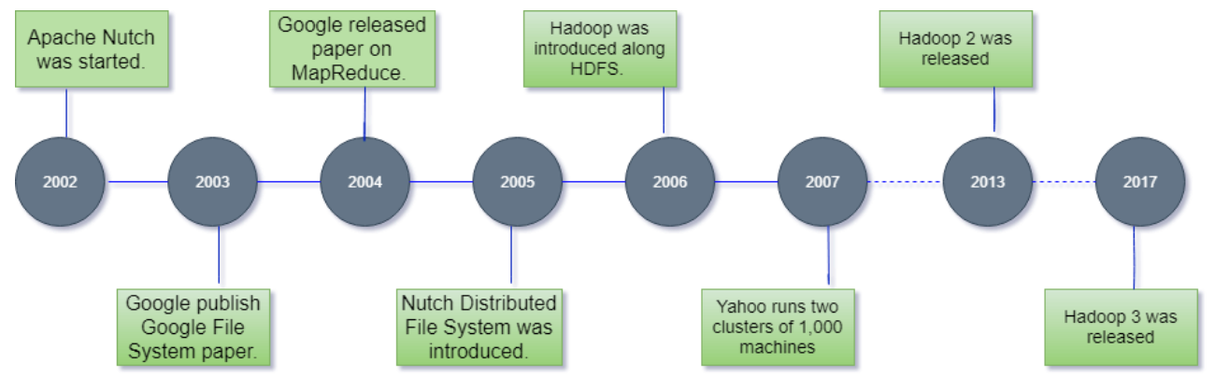
History of Hadoop

Slide 7
Hadoop Pros?
Cost Effective System
Computing power
Scalability
Storage flexibility
Varied Data Sources
Fault-Tolerant
Highly Available
Low Network Traffic
High Throughput(a measure of how many units of information a system can process in a given amount of time)

Slide 8
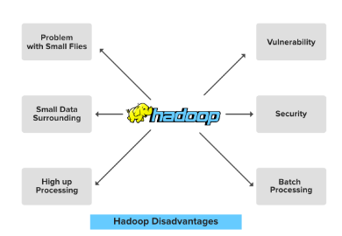
Hadoop Cons

Slide 9
Disadvantages of Hadoop
1. Problem with Small files:
Hadoop stores the file in the form of file blocks which are from 128MB in size(by default) to 256MB.
Hadoop fails when it needs to access the small size file in a large amount. This so many small files surcharge the Namenode and make it difficult to work.
Memory Prefix | Amount
Kilo (Kilobyte, KB) | 1,024 Bytes
Mega (Megabyte, MB) | 1,024 Kilobytes
Giga (Gigabyte, GB) | 1,024 Megabytes
Tera (Terabyte, TB) | 1,024 Gigabytes
Peta (Petabyte, PB) | 1,024 Terabytes

Slide 10
Disadvantages of Hadoop
2. Vulnerability.
Hadoop is a framework that is written in java, and java is one of the most commonly used programming languages which makes it more insecure as it can be easily exploited by any of the cyber-criminal

Slide 11
Disadvantages of Hadoop
3. Low Performance In Small Data Surrounding
Hadoop is mainly designed for dealing with large datasets, so it can be efficiently utilized for the organizations that are generating a massive volume of data.
It’s efficiency decreases while performing in small data surroundings

Slide 12
Disadvantages of Hadoop
4. Lack of Security
Data is everything for an organization, by default the security feature in Hadoop is made un-available. So the Data driver needs to be careful with this security face and should take appropriate action on it.
Hadoop uses Kerberos for security feature which is not easy to manage. Storage and network encryption are missing in Kerberos which makes us more concerned about it. (Kerberos -A protocol for authenticating service requests between trusted hosts across an untrusted network, such as the internet)

Slide 13
Traditional Way for parallel and distributed processing
let us take an example where I have a weather log containing the daily average temperature of the years from 2000 to 2015.
Here, we want to calculate the day having the highest temperature each year.
will split the data into smaller parts or blocks and store them in different machines.
Then, will find the highest temperature in each part stored in the corresponding machine.

Slide 14
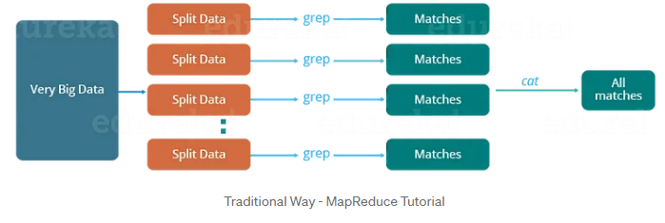
Traditional Way for parallel and distributed processing
At last, will combine the results received from each of the machines to have the final output.

Slide 15
Traditional Way for parallel and distributed processing
Let us look at the challenges associated with this traditional approach:
Critical path problem: It is the amount of time taken to finish the job without delaying the next milestone or actual completion date. So, if, any of the machines delay the job, the whole work gets delayed.
Reliability problem: What if, any of the machines which are working with a part of data fails? The management of this failover becomes a challenge.
Equal split issue: How to divide the data into smaller chunks so that each machine gets even part of data to work with. In other words, how to equally divide the data such that no individual machine is overloaded or underutilized.
Single split may fail: If any of the machines fail to provide the output, will not be able to calculate the result. So, there should be a mechanism to ensure this fault tolerance capability of the system.

Slide 16
Traditional Processing scenerio
MapReduce is a programming model that allows us to perform parallel and distributed processing on huge datasets.

Slide 17
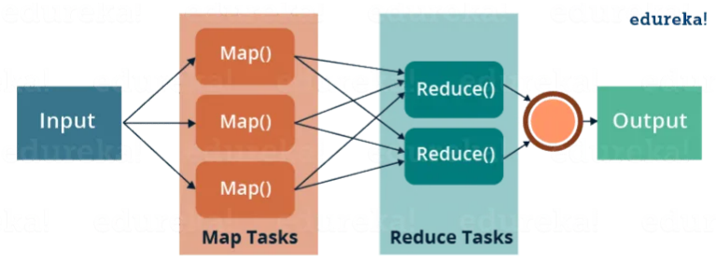
MapReduce for Parallel Processing
To overcome these issues, we have the MapReduce framework which allows us to perform such parallel computations without bothering about the issues like reliability, fault tolerance etc.
Therefore, MapReduce gives you the flexibility to write code logic without caring about the design issues of the system.
It totally depends on the logic inside the getSplits() method of your InputFormat.

Slide 18
MapReduce for parallel processing
MapReduce consists of two distinct tasks — Map and Reduce.
As the name MapReduce suggests, reducer phase takes place after the mapper phase has been completed.
So, the first is the map job, where a block of data is read and processed to produce key-value pairs as intermediate outputs.
The output of a Mapper or map job (key-value pairs) is input to the Reducer.
The reducer receives the key-value pair from multiple map jobs.
Then, the reducer aggregates those intermediate data tuples (intermediate key-value pair) into a smaller set of tuples or key-value pairs which is the final output.

Slide 19
MapReduce for Parallel Processing
Map task:
In the MapReduce framework, a "Map task" refers to an individual unit of work responsible for processing a portion of the input data.
Map tasks are executed in parallel across a cluster of machines, and they perform the mapping phase of the MapReduce job.
Flow of map
1. Input Data Splitting:
The input data, which can be a large dataset stored in Hadoop Distributed File System (HDFS), is divided into smaller, more manageable chunks called "splits" or "input splits."
Each Map task processes one input split.

Slide 20
MapReduce for Parallel Processing
2. Initialization:
Before processing begins, the Map task is initialized.
Initialization includes setting up any necessary resources, configuration, and preparing the context for the mapping phase.
3. Mapping Function Execution:
The core of the Map task's work is the execution of a user-defined Map function.
The Map function takes a single input split as its input and processes the data within that split.
4. Intermediate Key-Value Pair Emission:
As the Map function processes data within its input split, it emits intermediate key-value pairs as output.

Slide 21
Map Reduce for Parallel Processing
5. Output Serialization:
Before transferring data to the next phase (Shuffle and Sort), the intermediate key-value pairs are serialized, which means they are converted into a binary format for more efficient data transfer.
6. Cleanup:
  After processing the input split, the Map task performs any necessary cleanup, such as releasing resources or closing files.
7. Output to Shuffle and Sort (Intermediate Storage):
  The output of the Map tasks, which consists of serialized intermediate key-value pairs, is sent to the Shuffle and Sort phase.
  During this phase, the key-value pairs are grouped by key and sorted to prepare them for the subsequent Reduce phase.

Slide 22
Reduce Tasks
In the MapReduce framework, a "Reduce task" refers to an individual unit of work responsible for processing a group of intermediate key-value pairs generated by the Map phase.
Reduce tasks perform the reducing phase of the MapReduce job.
Workflow of Reduce task.
Input from Shuffle and Sort:
The input to a Reduce task is a group of intermediate key-value pairs that share the same key.
These key-value pairs are produced by the Map phase, shuffled, sorted by key, and grouped together so that all values for a particular key are sent to the same reducer.

Slide 23
Reduce tasks
2.Reducing Function Execution:
The core of the Reduce task's work is the execution of a user-defined Reduce function.
The Reduce function takes a key and a list of values (all values associated with that key) as input and performs some operation or computation on those values.
3. Output Emission:
As the Reduce function processes the list of values for a given key, it produces an output, which is typically a single key-value pair or a small set of key-value pairs.
These output key-value pairs represent the results of the reducing phase.

Slide 24
Reduce tasks
4. Final Output Storage or Transmission:
The output of the Reduce task is typically stored in HDFS or sent to another storage system, depending on the MapReduce job's configuration.
In some cases, the output might be transmitted to external systems or databases for further analysis or use.

Slide 25
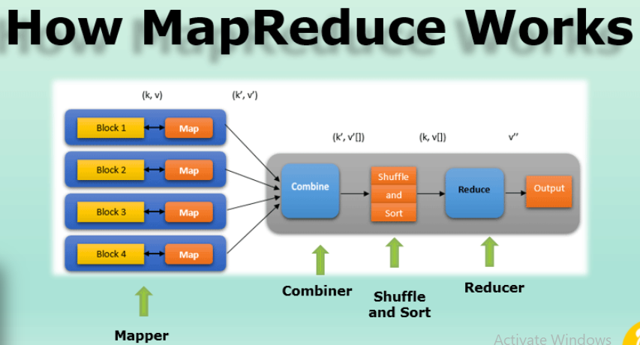

Slide 26
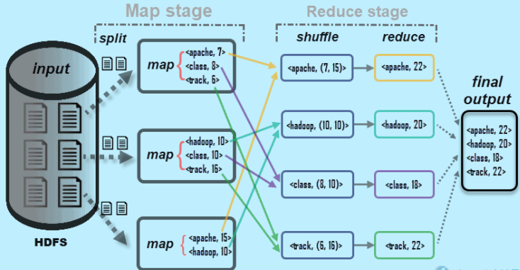

Slide 27
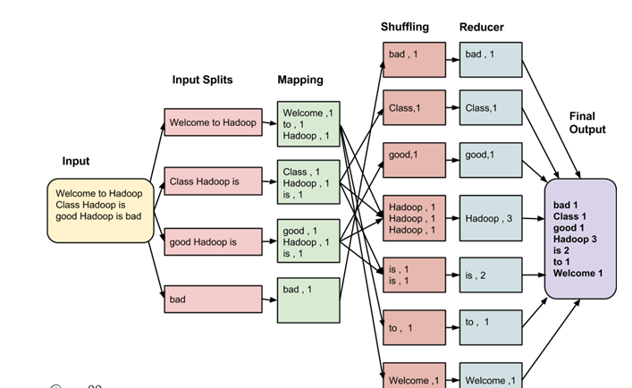
Map-reduce execution pipeline

Slide 28
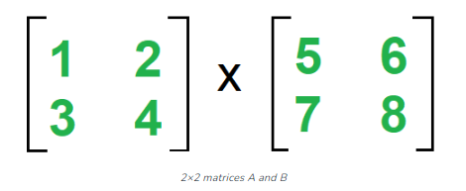
Matrix Multiplication in MapReduce
In mathematics, matrix multiplication or the
matrix product is a binary operation that produces a matrix from two matrices.

Slide 29
Matrix Multiplication in Mapreduce
Algorithm for Map Function.
a.for each element mij of M
  do produce (key,value) pairs as ((i,k), (M,j,mij), for k=1,2,3,.. upto the number of columns of N.
b. for each element njk of N
do produce (key,value) pairs as ((i,k),(N,j,N jk ), for i = 1,2,3,.. Upto the number of rows of M.
c. return Set of (key,value) pairs that each key (i,k), has list with values (M,j,mij) and (N, j,njk ) for all possible values of j.

Slide 30

Matrix Multiplication in Mapreduce
Algorithm for Reduce Function
for each key (i,k) do.
  sort values begin with M by j in list M
  sort values begin with N by j in list N
  multiply m ij and n jk for jth value of each list
  sum up mij x n jk return

Slide 31
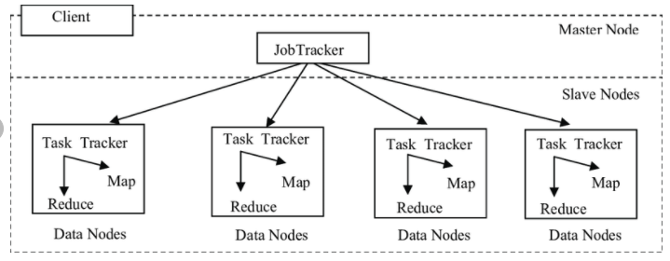
Map-reduce daemons
JobTrackers
TaskTrackers

Slide 32
JobTracker
The JobTracker is a critical component of MRv1 and played a central role in managing and coordinating MapReduce jobs.
The JobTracker is a master daemon (process) that ran on the master node (usually the NameNode machine) in a Hadoop cluster.
Its primary responsibilities included job scheduling, resource management, and job monitoring for MapReduce jobs.
When a user submitted a MapReduce job, the JobTracker was responsible for breaking it down into tasks (Map tasks and Reduce tasks) and assigning those tasks to available TaskTrackers in the cluster.

Slide 33
Job Tracker
Key Functions of the Job Tracker:
1. Job Scheduling:
The Job Tracker determined the order in which jobs were executed in the cluster.
It also managed job priorities and decided which jobs should be allocated resources first.
2. Task Assignment:
The Job Tracker assigned Map and Reduce tasks to Task Trackers based on data locality and availability of resources.
It aimed to assign tasks to nodes where the data needed for processing (for Map tasks) or the intermediate data (for Reduce tasks) was already present, reducing data transfer over the network.

Slide 34
Job Tracker
Key Functions of the Job Tracker:
3. Monitoring and Fault Tolerance:
The Job Tracker continuously monitored the progress of all tasks in the cluster.
If a task failed, it was responsible for reassigning that task to another available Task Tracker.
It kept track of task completion and reported the final status of the job.

Slide 35
Task Tracker
A TaskTracker Is a worker daemon (process) that ran on slave nodes in a Hadoop cluster.
Its primary purpose was to execute Map and Reduce tasks as directed by the JobTracker (a master daemon).
Key Functions of the TaskTracker:
Task Execution:
The TaskTracker was responsible for executing both Map and Reduce tasks.
It launched task processes on its node to process a specific portion of the data.
2. Heartbeats and Status Updates:
TaskTrackers regularly sent heartbeats to the JobTracker to indicate that they were alive and functioning.
They also send status updates to inform the JobTracker about the progress of individual tasks.

Slide 36
Task Tracker
3. Data Localization:
TaskTrackers were aware of the data locality in the cluster. They preferred to execute tasks on the nodes where the data required for that task was already present, reducing network data transfer.
4. Task Retry:
If a task failed (e.g., due to a node failure or a software error), the TaskTracker could retry the task.
If a task repeatedly failed, the JobTracker was informed, and it might decide to reassign the task to another TaskTracker.
Cleanup:
After a task completed successfully or failed, the TaskTracker was responsible for cleaning up any temporary files or resources associated with that task.

Slide 37
Map Reduce Limitations
Here are some of the key limitations of MapReduce:
Latency for Small Jobs:
MapReduce is optimized for processing large datasets. For small jobs, the overhead of job initialization, task scheduling, and data shuffling can lead to high latency. Real-time or low-latency processing is not its strength.
Complexity:
Writing MapReduce programs can be complex and requires understanding of distributed systems concepts. Debugging and optimizing MapReduce jobs can also be challenging.
Disk I/O:
MapReduce jobs often involve significant disk I/O due to the storage and retrieval of intermediate data during the shuffle and sort phase. This can lead to performance bottlenecks, especially on clusters with slow disk storage.
Resource Management:
Resource management in MapReduce clusters can be inflexible. Jobs are allocated resources at the beginning and hold them until completion, which may lead to inefficient resource utilization, especially in multi-tenant clusters.

Slide 38
API
Main Class file Packages
Mapper Class Packages
Reducer Class Packages

Slide 39
Main class file packages
import org.apache.hadoop.conf.Configured; (Configuration of system parameters)
import org.apache.hadoop.fs.Path; (Configuration of file system path)
import org.apache.hadoop.io.IntWritable; (Input/output package to display in output screen)
import org.apache.hadoop.io.Text; ( to read and write the text)
import org.apache.hadoop.mapred.FileInputFormat; ( MapRed file input format)
import org.apache.hadoop.mapred.FileOutputFormat; ; ( MapRed file output format)
import org.apache.hadoop.mapred.JobClient; ( assign the input job and process)
import org.apache.hadoop.mapred.JobConf; (configuration file to execute I/O process)

Slide 40
import org.apache.hadoop.util.Tool; (interface (command line options) used to access MapRed functions)
import org.apache.hadoop.util.ToolRunner;
( Interface used to call run function)

Slide 41
Mapper File Packages
import java.io.IOException; ( Exception handle)
import org.apache.hadoop.io.IntWritable; ( to read the integer file)
import org.apache.hadoop.io.LongWritable; (to read files range exceeding integer)
import org.apache.hadoop.io.Text; (Input and output text)
import org.apache.hadoop.mapred.MapReduceBase;( Inherited class of MapReduce functions)
import org.apache.hadoop.mapred.Mapper; (Mapper Class)
import org.apache.hadoop.mapred.OutputCollector; ( to collect and display class)
import org.apache.hadoop.mapred.Reporter; (to display the information)

Slide 42
Reducer file Package
import java.io.IOException; ( Exception handle)
import java.util.Iterator; (to call utility function has more elements from iterator class)
import org.apache.hadoop.io.IntWritable; ( to read the integer file)
import org.apache.hadoop.io.Text; (Input and output text)

Slide 43
Installing a Hadoop cluster typically involves unpacking the software on all the machines in the cluster or installing it via a packaging system as appropriate for your operating system.
It is important to divide up the hardware into functions.

Slide 44
Typically one machine in the cluster is designated as the NameNode and another machine as the ResourceManager, exclusively. These are the masters.
Other services (such as Web App Proxy Server and MapReduce Job History server) are usually run either on dedicated hardware or on shared infrastructure, depending upon the load.
The rest of the machines in the cluster act as both DataNode and NodeManager. These are the workers.

Slide 45
Reducer file Package
import org.apache.hadoop.mapred.MapReduceBase; ( Inherited class of MapReduce functions)
import org.apache.hadoop.mapred.OutputCollector; ( to collect and display class)
import org.apache.hadoop.mapred.Reducer; (Reducer Class)
import org.apache.hadoop.mapred.Reporter; (to display the information)

Slide 46
Hadoop 2.0 features
HDFS Federation – horizontal scalability of NameNode
NameNode High Availability – NameNode is no longer a Single Point of Failure (one hadoop cluster could have only one namenode) –HDFS Federation overcomes this.
YARN – ability to process Terabytes and Petabytes of data available in HDFS using Non-MapReduce applications such as MPI, GIRAPH

Slide 47
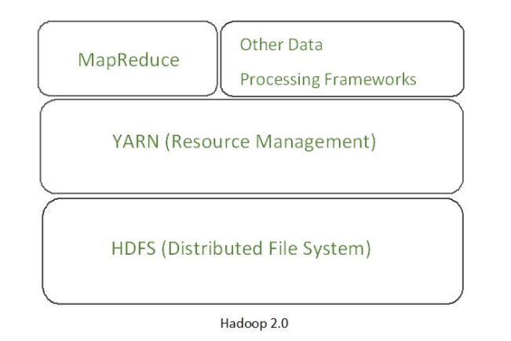

Slide 48
Hadoop 2.0 features
Resource Manager
Capacity Scheduler
Data Snapshot
Support for Windows

Slide 49
Hadoop 2.0 features
Resource Manager – splits up the two major functionalities of overburdened JobTracker (resource management and job scheduling/ monitoring) into two separate daemons:
A global Resource Manager and per-application ApplicationMaster

Slide 50
Hadoop 2.0 features
Capacity Scheduler
The CapacityScheduler is designed to run Hadoop applications as a
        shared,
        Multi-tenant cluster
in an operator-friendly manner while maximizing the throughput and the utilization of the cluster.

Slide 51
Hadoop 2.0 features
Capacity Scheduler - Features
        Hierarchical Queues
        Capacity Guarantees
        Security
        Elasticity
        Multi-tenancy
        Resource-based Scheduling -
1. Hierarchical Queues - Hierarchy of queues is supported. It ensures that resources are shared among the sub-queues of an organization before other queues are allowed to use free resources, thereby providing more control and predictability.
2. Capacity Guarantees - All applications submitted to a queue will have access to the capacity allocated to the queue. Administrators can configure soft limits and optional hard limits on the capacity allocated to each queue.

Slide 52
Hadoop 2.0 features
3. Security - Every organization has unique Queue. Users of queses cannot modify or delete application or properties belonging to other queues.
4. Elasticity - In some cases,Free resources can be allocated to any queue beyond its capacity. Capacity Scheduler ensures that resources are available in a predictable and elastic manner to queues, thus preventing artificial silos(isolate) of resources in the cluster which helps utilization.

Slide 53
Hadoop 2.0 features
5. Multi-tenancy - Comprehensive set of limits are provided to prevent a single application, user and queue from monopolizing resources of the queue or the cluster as a whole to ensure that the cluster isn’t overwhelmed.
6. Resource-based Scheduling - Support for resource-intensive applications, These applications specify higher resource-requirements than the default, thereby accommodating applications with differing resource requirements.

Slide 54
Hadoop 2.0 features
Data Snapshot
HDFS Snapshots are read-only point-in-time copies of the file system. Snapshots can be taken on a subtree of the file system or the entire file system. Some common use cases of snapshots are data backup, protection against user errors and disaster recovery.
Support for Windows

Slide 55
Namenode high availability
Hadoop 1.x, NameNode was single point of failure
Hadoop Administrators need to manually recover the NameNode using Secondary NameNode.
Hadoop 2.0 Architecture supports multiple NameNodes to remove this bottleneck
Passive Standby NameNode support.
In case of Active NameNode failure, the passive NameNode becomes the Active NameNode and starts writing to the shared storage

Slide 56
YARN(Yet Another Resource Negotiator)
Main idea is splitting the JobTracker responsibility of resource management and Job scheduling into separate daemons.

Slide 57
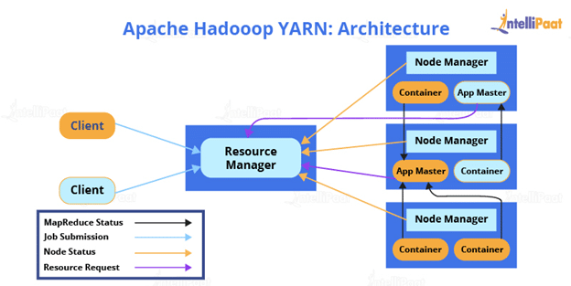
YARN Architecture

Slide 58
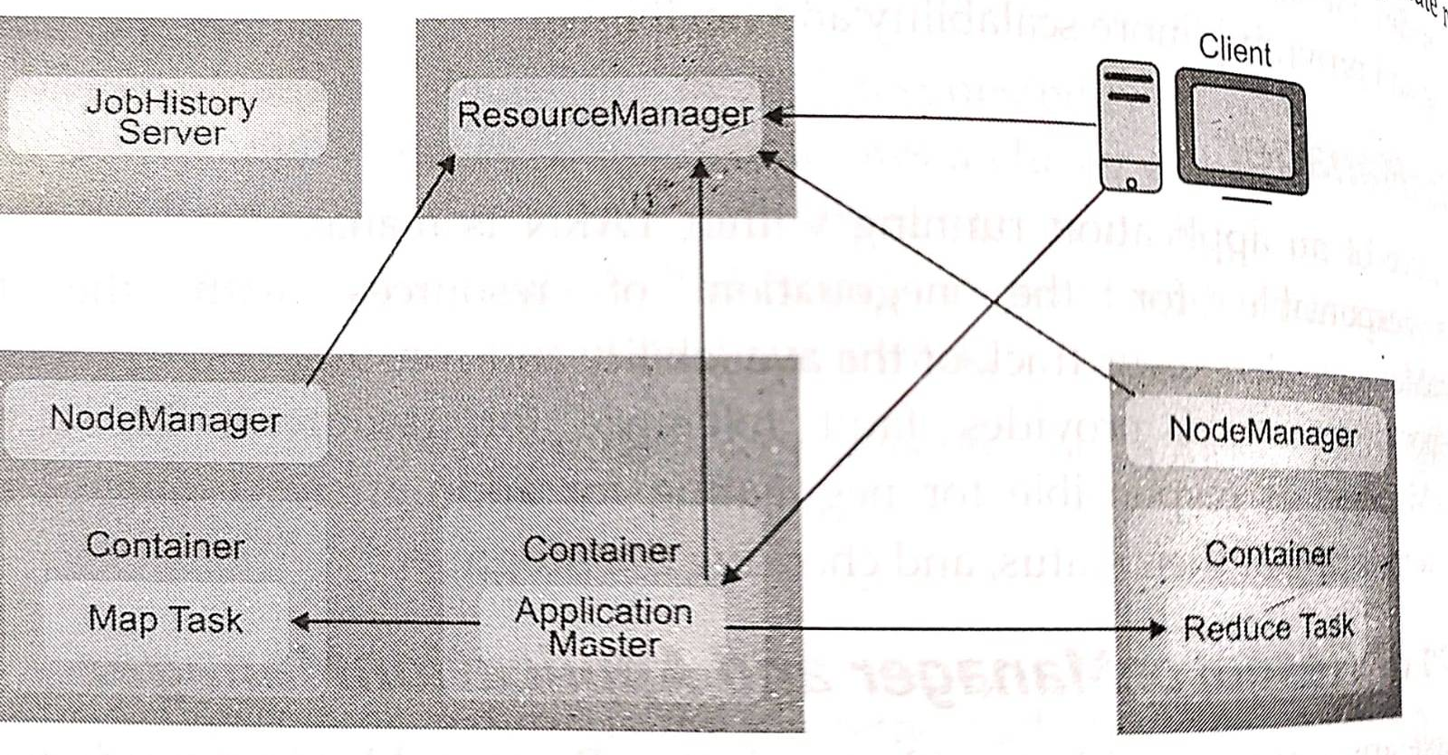
Architectural view of YARN

Slide 59

Architectural View of YARN
JobHistory Server
ResourceManager
NodeManager
NodeManager
Container
Container
Container
Map Task
Application Msster
Reduce Task

Slide 60
YARN daemons
Global resource manager:
Scheduler(allocation of resources among various running applications)
Application manager(Accepting job submission, restarting application master in case of failure)

Slide 61
YARN daemons
2. Node manager:
Per-machine slave daemon
Responsible for Launching application container for application execution
Monitor and Report usage of resources to the global resource manager

Slide 62
YARN daemons
3. Application master:
Application specific entity
Negotiate required resources for execution from the resource manager
Works with node manager for executing and monitoring component tasks

Slide 63
Job History Service
Responsible for tracing the job status
Usually run on separate node
Container
Consists of CPU, Memory,disks etc

Slide 64
YARN workflow
Client submits an application
The Resource Manager allocates a container to start the Application Manager
The Application Manager registers itself with the Resource Manager
The Application Manager negotiates containers from the Resource Manager
The Application Manager notifies the Node Manager to launch containers
Application code is executed in the container
Client contacts Resource Manager/Application Manager to monitor application’s status
Once the processing is complete, the Application Manager un-registers with the Resource Manager

Slide 65
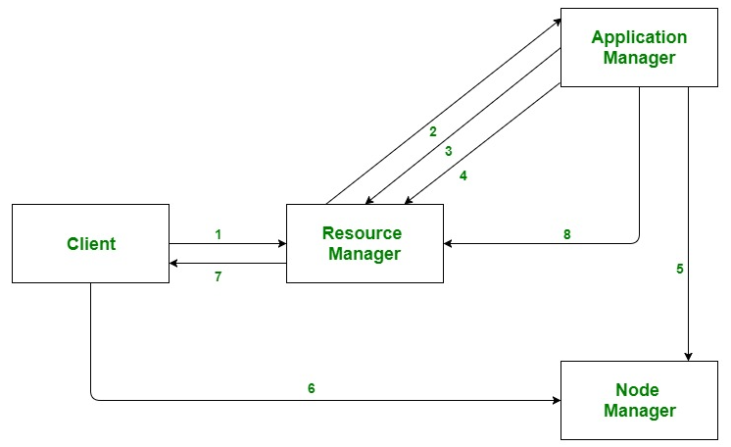
YARN

Slide 66
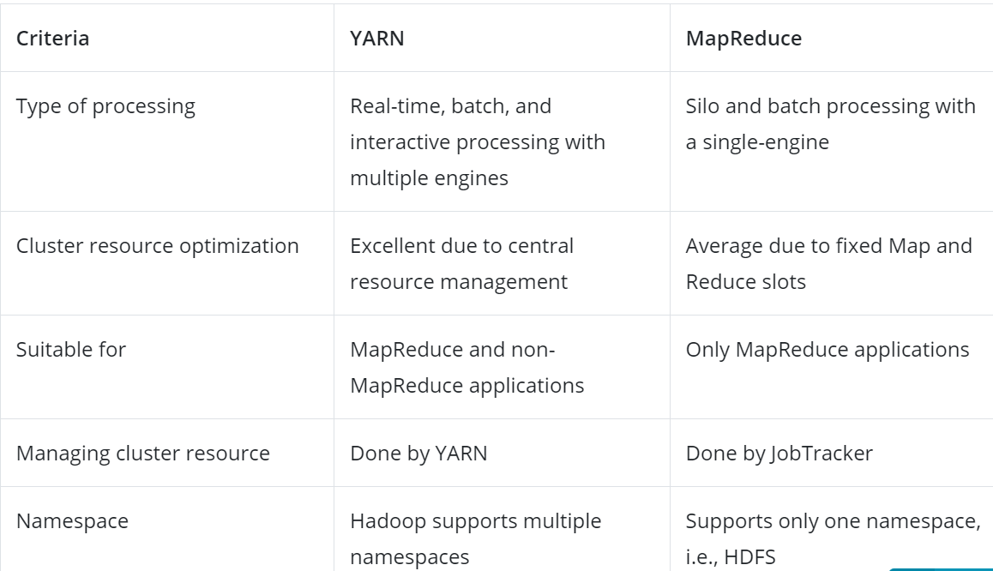
YARN Vs MapReduce

Slide 67


